Slide 1
HAPPINESS SCORES
PREDICTION
Siddiga Gadirova
Narmin Babayeva
Dilbar Huseynzade

Slide 2
Table of content
About project
Linear Regression Heatmap
Random Forest Heatmap
XGBoost Heatmap
Metrics Comparison Heatmap
Summary per country
Final takeaways
Lessons learned

Slide 3
Project type: Regression-based analysis
Problem: Predict country's happiness score based on economic and social indicators like GDP, inflation levels, corruption, freedom. What makes people happier?
Why it matters:
Happiness is a growing global metric for development
Governments and organizations want to know what really makes people happy, not just how rich a country is.
This is a real-world problem with social impact.

Slide 4

Top 10 happiest countries
Finland
Denmark
Iceland
Switzerland
Norway
Netherlands
Sweden
New Zealand
Canada
Australia

Slide 5
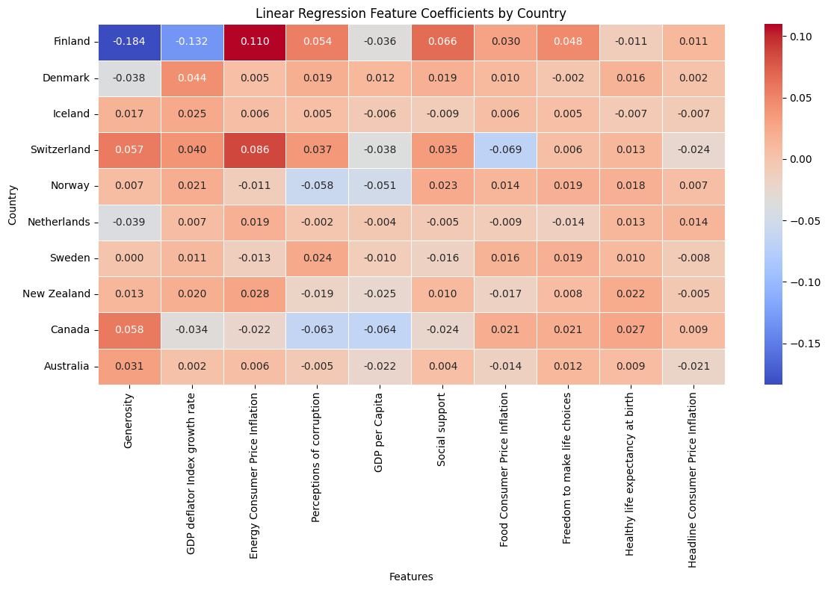

Slide 6
Linear Regression Heatmap (Coefficients)
The actual direction and strength of influence per feature, per country.
Positive values: which feature increases happiness
Negative values: which feature decreases happiness
Highlights:
Finland: Generosity and GDP deflator growth rate negatively associated with happiness. Energy price inflation is the strongest positive driver.
Canada: Generosity and Life Expectancy are positive. Perceptions of Corruption is strongly negative.
Switzerland: Balanced but Energy CPI has a clear positive effect.

Slide 7
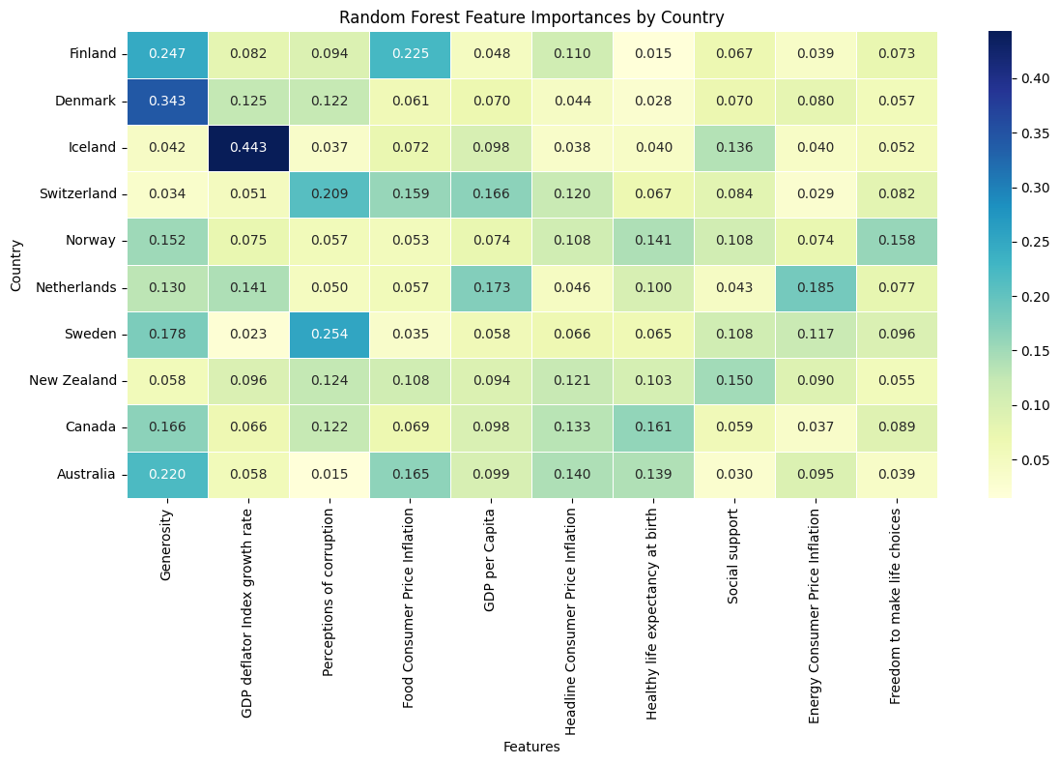

Slide 8
Random Forest Heatmap (Feature Importances)
The importance of each feature in making predictions, but not direction (only strength).
Highlights:
Denmark and Finland: Generosity is highly important — matches global happiness index logic.
Iceland: GDP deflator is strongest — inflation sensitivity.
Switzerland: GDP per capita is top — suggests economic satisfaction drives happiness.

Slide 9
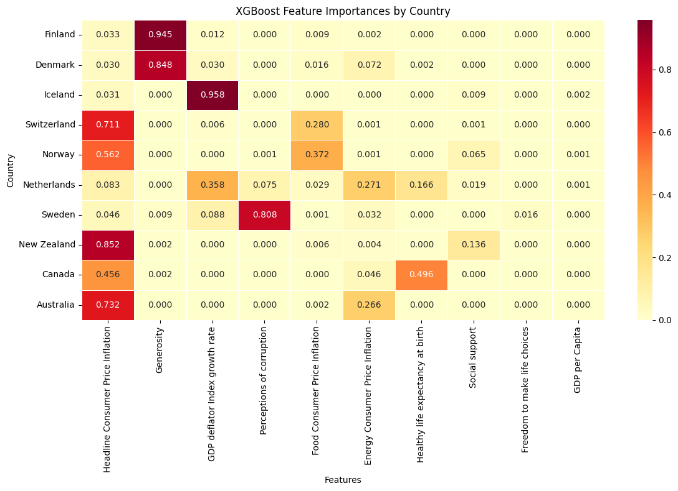

Slide 10
XGBoost Heatmap (Feature Importances)
More aggressive pattern: usually picks 1 dominant feature per country, discards others.
Highlights:
Finland: Generosity (0.94!) — extreme dependence.
Iceland: GDP deflator — strong and singular.
Canada: Life expectancy & Energy inflation — standout contributors.
Switzerland: Headline CPI and Food CPI — shows overfitting risk (too sharp reliance).

Slide 11
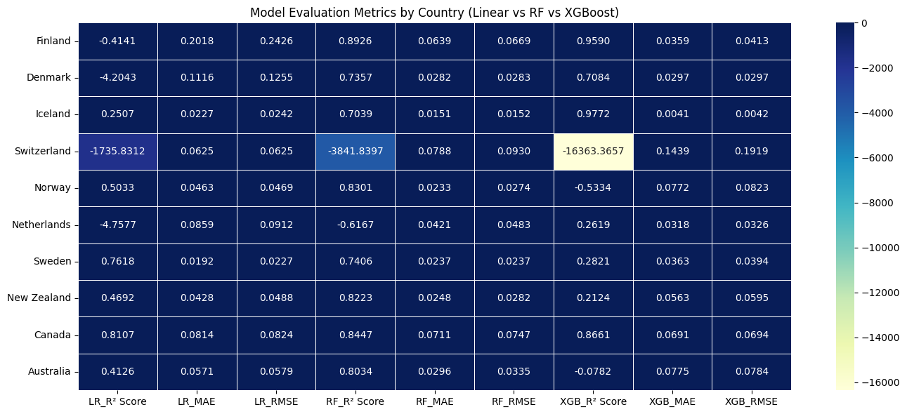

Slide 12
Metrics Comparison Heatmap (R², MAE, RMSE)
Model accuracy and error by country
R² closer to 1 = better, negative = worse than average
MAE and RMSE lower = better

Slide 13
Country | Best Model | Why
Finland | XGBoost | R² = 0.96, very low MAE/RMSE
Denmark | Random Forest | R² = 0.73, XGB overfit a bit, Linear failed
Iceland | XGBoost | Near perfect prediction (R² = 0.97)
Switzerland | None | All models failed — XGB worst (R² = -16000+), small or unstable data
Norway | Random Forest | R² = 0.83, reliable error scores
Netherlands | Random Forest | Others failed (R² = -4.7 for Linear, -0.6 for XGB)
Sweden | Linear | R² = 0.76, best balance
New Zealand | Random Forest | R² = 0.82, low error
Canada | XGBoost | R² = 0.87, lowest MAE
Australia | Random Forest | Best generalization (XGB failed again)
Summary
per country

Slide 14
Final Takeaways
Linear Regression is good for understanding direction of influence, but underperforms in accuracy.
Random Forest is the most stable and reliable model overall, especially in countries with moderate data sizes.
XGBoost is highly accurate in data-rich countries (Finland, Canada, Iceland), but it is too aggressive in low-sample cases (Switzerland).
Generosity and GDP indicators are the most frequent top drivers, but their effect varies by country and model.
Switzerland highlights a limitation of using powerful models on weak data — future improvements could include more time periods or additional features.

Slide 15
What we learned
Data isn't perfect
real datasets require cleaning, fixing missing values, and careful preprocessing.
Model performance varies
some models like XGBoost overfit small data
Random Forest is more stable.
Key drivers differ
each country has different top features influencing happiness (e.g., generosity vs. inflation).
Metrics matter
comparing R², MAE, RMSE helped us choose the best model per country.
Teamwork is essential
coordinating tasks and handling unexpected issues improved our project management skills.

Slide 16
Link to repository:
https://github.com/sqadirova/BDA_project_2025

Slide 17
Any questions?

